Slide 1
Discrete Mathematics
Can we solve problems?
Propositions – Lesson 3
October 3rd, 2013

Slide 2
Decide which sentences are propositions. What are the truth values of those that are propositions?
What time is it?
Answer: No
Do not play with pen.
Answer: No
Dhaka is the capital city of Bangladesh.
Answer: Yes. True

Slide 3
What is the negation of each of these propositions?
Carlos is a boy
Answer: Carlos is not a boy
2+3=8
Answer:2+3≠8

Slide 4
Construct truth tables for each propositions
“The sun is shining and it is raining.”
“The sun is shining, but it is raining”
“The sun is shining or it is raining”
“Students who have taken calculus or computer science can take this class.”
“Students who have taken calculus or computer science, but not both, can enroll in this class.”

Slide 5
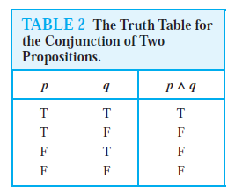
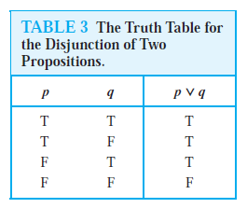
Truth table for Disjunction Conjunction

Slide 6
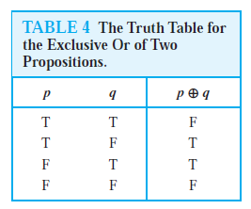
Truth table for Exclusive Or

Slide 7
Construct truth tables for each propositions
“If I am elected, then I will lower taxes.”
“If you get 100% on the final, then you will get an A.”
“If it is sunny, then we will go to the beach.”

Slide 8
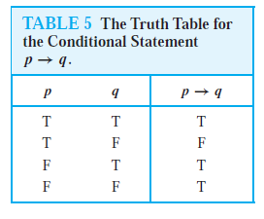
The Truth Table for the Conditional Statement or implication

Slide 9
Construct truth tables for each propositions
“You can take the flight if and only if you buy a ticket.”
“You can have dessert if and only if you finish your meal.”

Slide 10
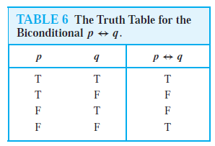
The Truth Table for the Bi-conditional statement

Slide 11
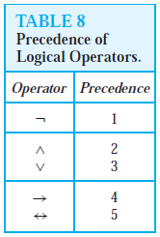
Precedence of Logical Operators
1. p ∧ q ∨ r means (p ∧ q) ∨ r
2.￢p ∧ q is the conjunction
of ￢p and q i.e (￢p) ∧ q

Slide 12
Class Task
Construct the truth table of the compound proposition
(p ∨￢q) → (p ∧ q).

Slide 13
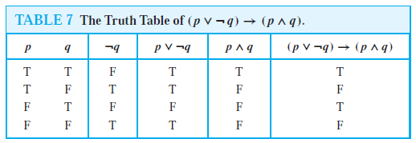
Compare with your answer

Slide 14
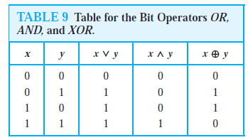
Logic and Bit Operations
A bit is a symbol with two possible values, namely,
0 (zero) and 1 (one).
1 represents T (true), 0 represents F (false)

Slide 15
Group work 1
Let p and q be the propositions “The game is over” and “The winner got the prize” respectively. Express each of these compound propositions as an English sentence.
a)￢p b) p ∨ q c) ￢p ∧ q
d) q → p e) ￢q →￢p
f ) ￢p →￢q g) p ↔ q

Slide 16
Group work 2
Let p and q be the propositions
p :You drive over 65 miles per hour.
q :You get a speeding ticket.
Write these propositions using p and q and logical connectives .
a) You do not drive over 65 miles per hour.
b) You drive over 65 miles per hour, but you do not get a speeding ticket.
c) You will get a speeding ticket if you drive over 65 miles per hour.
d) If you do not drive over 65 miles per hour, then you will not get a speeding ticket.
e) Driving over 65 miles per hour is sufficient for getting a speeding ticket.
f ) You get a speeding ticket, but you do not drive over 65 miles per hour.
g) Whenever you get a speeding ticket, you are driving over 65 miles per hour.

